Slide 1

Gambling
IS GAMBLING WISE FINANCIAL MANAGEMENT?

Slide 2


Gambling
Defn: Gambling, according to the Concise English dictionary, “is playing games of chance for money.”
In Kenya over the past few years, there has been an explosion of betting sites where people can go and bet, mostly on football matches played in different parts of the world, from Europe to Asia, in the hopes of winning some cash.
the Betting Control and Licensing Board have licensed a number of companies here in Kenya for this in recent years to conduct this betting
. Most come with easy payment methods such as mobile money, mobile banking and online payments

Slide 3
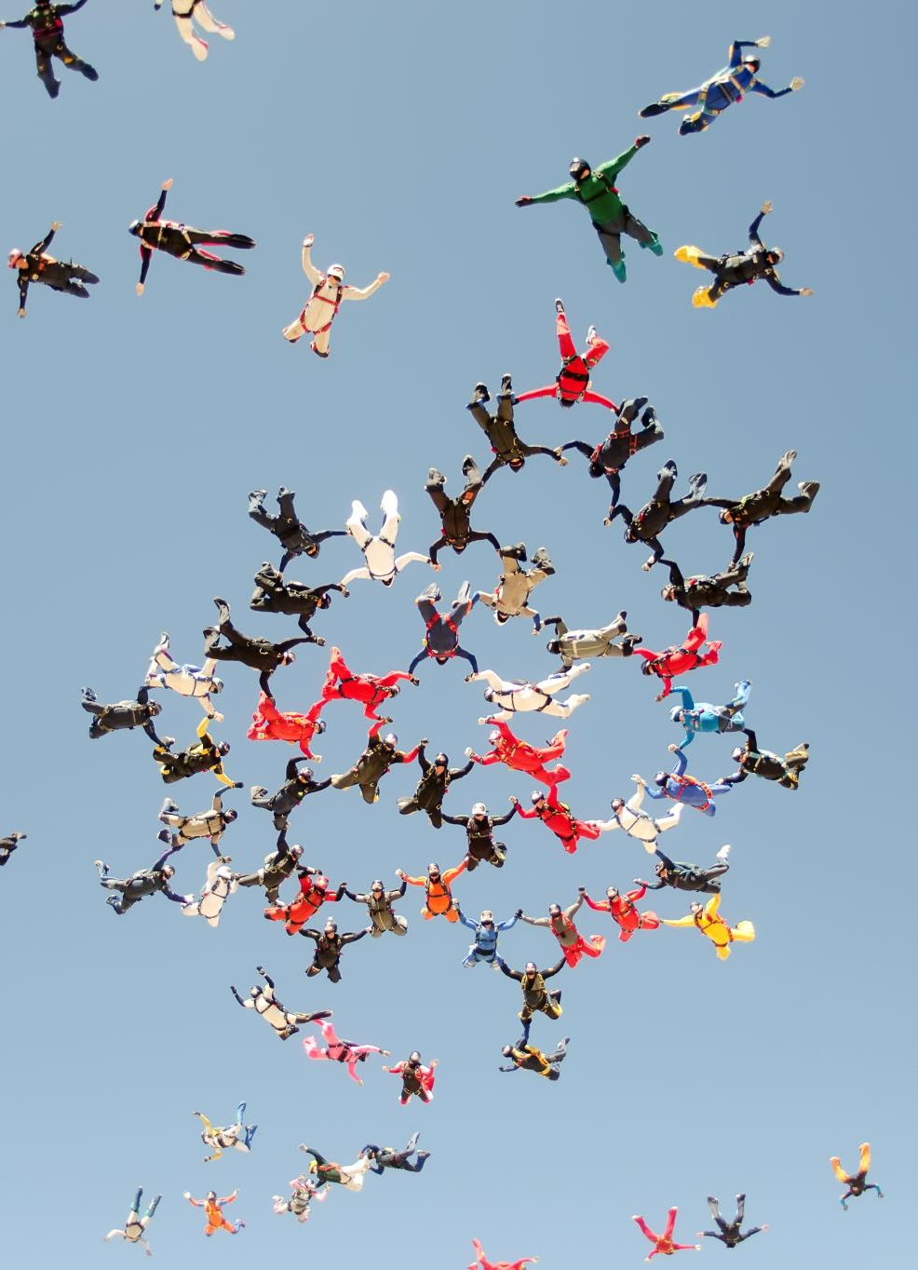
Why do people gamble?
According to the UK Mental Health Foundation, people gamble because of a variety of reasons, most common being “the buzz, the competitive element, the thrill of risk taking, of placing large bets, to solve financial problems and as a way of escaping from stress or worries.”

Slide 4

How can one gamble responsibly?
always bet what they can afford to lose
people should always quit while they are still ahead, because, eventually, the house always wins.
gamble for very few hours of the day, concentrating on more important matters such as family, work, job hunting or school.
, if one is to bet, then some time spent researching on the teams is only sensible

Slide 5
How does one know that they have a betting problem?
if; one is spending too much money on it,
until it is all they think about,
they find themselves borrowing money to bet,
they get into financial difficulties, or
they think that all their financial problems can be solved by betting and scoring a large one

Slide 6
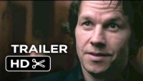
The Gambler Trailer on Youtube
Gambling movie trailer

Slide 7

So, is gambling good financial management?
95% of the time, it is not.
Few people are professional gamblers, and those that do it, live very boring lives and bet small.
Once in a while, it can be fun. But, be very, very careful, and when the fun stops, stop

Slide 8
Links to Gambling addiction help sites
https://gamhelpkenya.com/
https://sharewithacounsellor.com/gambling-addiction-counselling-in-kenya.html

Slide 9



Thanks for watching,
give me a good mark in the exam please!!

